Slide 1

AutoTestDesign
AI-Driven Test Design Tool
Software Testing Final Project
2353408 周由 2352191 吴昀洁 2354447 陈萨宇
2353814 马小龙 2351707 马敏慧智

Slide 2
CONTENTS
01
The Problem & Our Idea
02
System Design
03
Test Design
04
Result Analysis

Slide 3

Chapter 1
The Problem & Our Idea

Slide 4


01
The Problem & Our Idea
The Problem
Slow. Designing and executing a complete test suite for a backend with 12 requirements manually can require around 20 person-hours.
Inconsistent. Different engineers often interpret and test the same requirement differently, leading to coverage variability across testers.
Gap-prone. Boundary conditions, cross-condition combinations, and invalid state transitions are frequently overlooked when relying primarily on intuition.
Hard to audit. Maintaining traceability between requirements and tests becomes increasingly difficult as the test suite expands.

Slide 5



01
The Problem & Our Idea
Our approach — AutoTestDesign
The system adopts an AI-assisted, technique-driven workflow in which an LLM structures requirements and assesses risk while deterministic rule engines apply EP, BVA, decision-table, and state-transition coverage. Human-in-the-loop interaction is preserved throughout the process: every intermediate artefact remains editable, and modifications automatically invalidate downstream outputs. The tool not only automatically generates deliverables compliant with IEEE 829, but also produces validation evidence by executing generated test cases against a real Django backend. To ensure reproducibility, identical inputs always produce identical test suites byte-for-byte, while LLM-dependent components automatically fall back to rule-based execution when offline.

Slide 6
Chapter 2
System Design

Slide 7
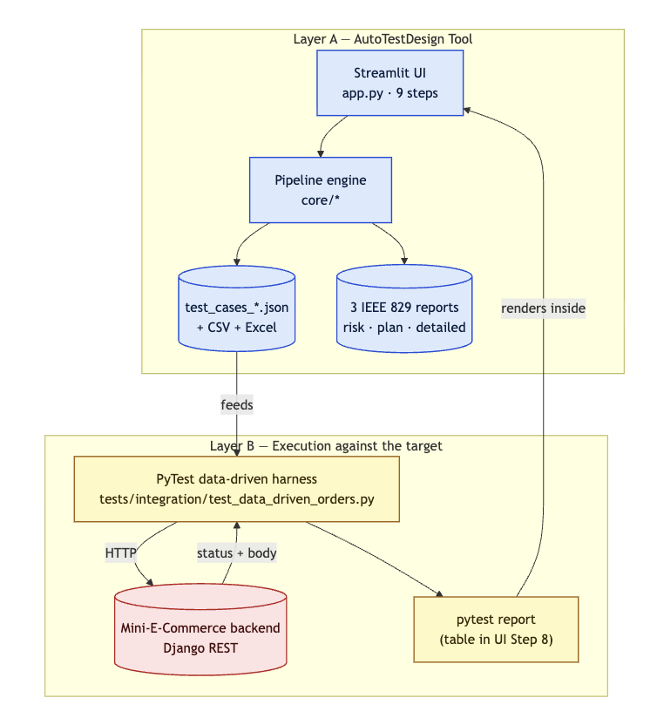
02
System Design
Two-layer model
Layer A — Tool. AutoTestDesign transforms natural-language requirements into structured testing artefacts (app.py + core/*).
Layer B — Execution. PyTest executes these artefacts against the target Django backend (tests/ + target_app/).
Step 8 closes the loop. Layer B is invoked directly from Layer A, enabling the complete end-to-end workflow to run within a single browser session.

Slide 8
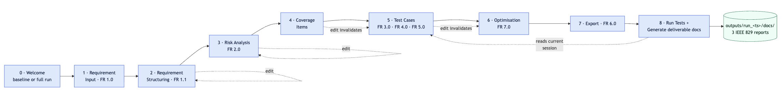
02
System Design
Step | Page | FR satisfied
1 | Requirement input | FR 1.0
2 | Structuring | FR 1.1
3 | Risk analysis | FR 2.0
4 | Coverage items | FR 3.0 input
5 | Test cases + oracle + state coverage | FR 3.0 / 4.0 / 5.0
6 | Optimisation | FR 7.0
7 | Export | FR 6.0
8 | Run tests + Generate deliverable docs | end-to-end execution
Eight-Step Workflow

Slide 9
Chapter 3
Test Design

Slide 10
03
Test Design —— Black-Box Test Design
Technique map
Worked example —— REQ-009 (quantity ≤ stock, stock = 10)
Coverage type | Technique | Rule
positive / negative | Equivalence Partitioning (EP) | one representative per class
boundary | Boundary Value Analysis (BVA) | values on and around the limit
multi-condition | Decision Table Testing (DT) | combinations across constraints
Equivalence Partitioning (EP)
01
REQ-009 defines constraints on order quantity, which allows the input space to be divided into valid and invalid partitions. Valid inputs contain positive quantities that satisfy business constraints, while invalid inputs violate those constraints. A representative negative test case uses quantity = 0, which belongs to the invalid partition and should therefore be rejected by the system. This negative representative exposed the missing validation logic that later became Defect 1.
Boundary Value Analysis (BVA)
02
REQ-009 includes a numerical constraint where the requested quantity must not exceed available stock. Assuming stock equals 10, boundary testing focuses on values immediately around this limit. The generated boundary trio uses quantities 9, 10, and 11 to verify behavior below the limit, exactly at the limit, and above the limit respectively. This ensures validation logic behaves correctly around constraint boundaries rather than only for typical values.
Different coverage goals require different test design techniques. Equivalence Partitioning is used to cover positive and negative behaviours by selecting representative values from each class. Boundary Value Analysis targets values at and around limits, while Decision Table Testing focuses on combinations across multiple constraints.
Decision Table Testing (DT)
03
Multi-item orders introduce combinations of constraints that cannot be captured by single-input testing alone. Decision Table Testing generates cases that combine conditions across order items. One representative scenario creates an order where the first item is valid while the second item is out of stock. This combination verifies whether partial execution incorrectly mutates system state and was later used to expose the atomicity defect.

Slide 11
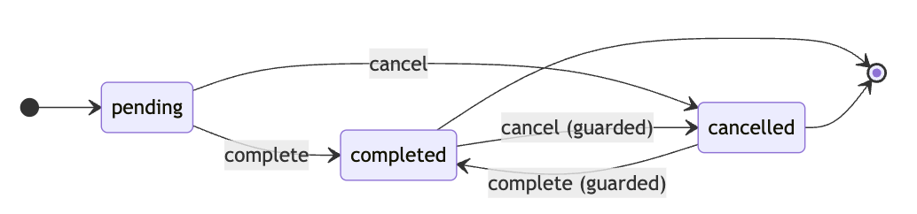
03
Test Design —— White-Box Test Design
White-box testing designs tests using knowledge of the system’s internal structure rather than relying only on input-output behaviour. Instead of checking whether functionality works externally, it focuses on verifying internal logic, execution paths, and state changes inside the implementation.
Some behaviours cannot be validated using isolated inputs alone because correctness depends on previous operations and current system state. Order processing is one such example: the validity of an action depends on the order’s existing status. In this example,completed and cancelled are terminal states and therefore should reject further status changes.
Order Status Machine

Slide 12
03
Test Design —— Oracle
In our project, each generated test case is attached with a structured oracle describing expected behaviour after execution.
The oracle supports multiple validation dimensions:
HTTP Status Validation — verifies whether returned status codes fall within the expected range
Response Content Validation — checks whether required or forbidden keywords appear in responses
Side-Effect Validation — validates system state changes such as inventory updates, rollback behaviour, or database mutations
This design enables generated tests to be executed and evaluated automatically without manual judgement.
{
"http_status_min": 400,
"http_status_max": 400,
"must_contain": ["stock"],
"must_not_contain": [],
"side_effect": {}
}
Structured Test Oracle

Slide 13
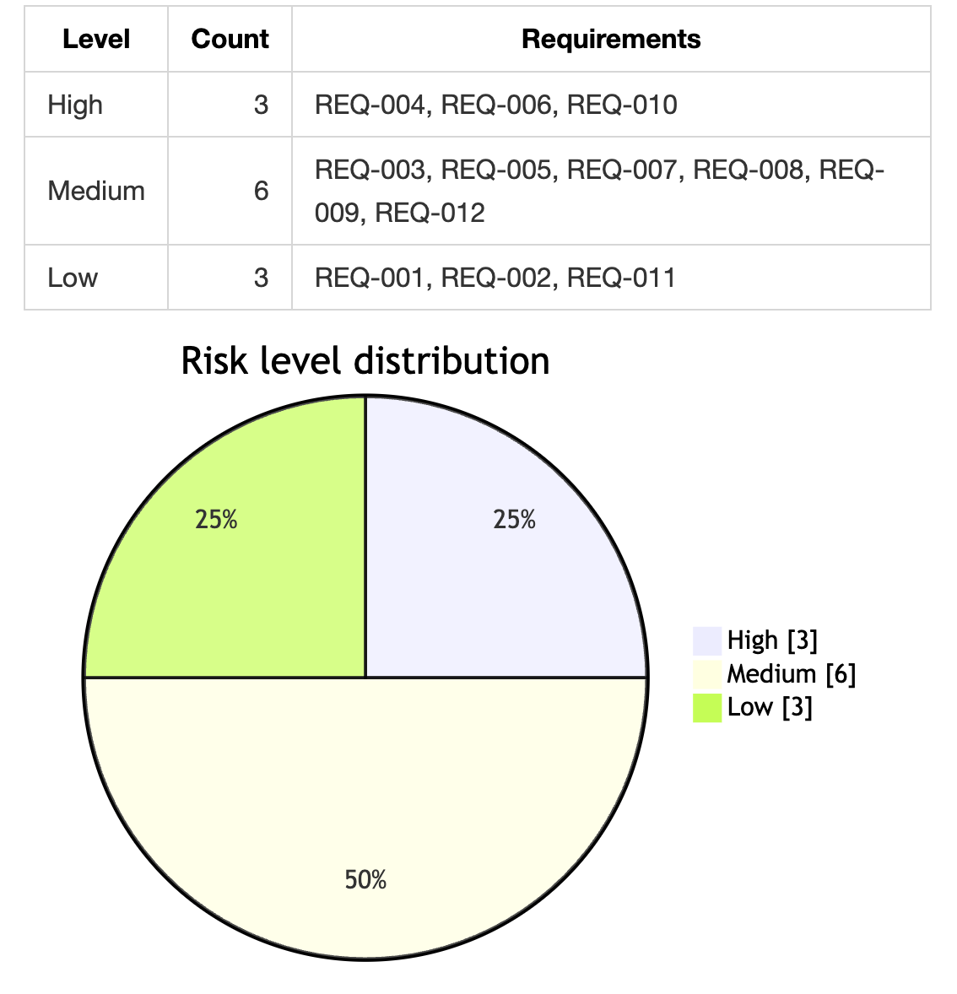
03
Test Design —— Risk Analysis
Not all requirements deserve the same testing effort. Risk analysis prioritises testing resources by identifying requirements with higher likelihood or impact of failure.
In our project, Each requirement is evaluated across four dimensions:
Dimension | Purpose
Business Impact | Importance of the functionality
Failure Probability | Likelihood of undetected defects
Complexity | Input and logic complexity
Failure Impact | Consequences of failures
Each dimension is rated from 1 (Low) to 3 (High).
Scores are converted into three risk levels:
Low: 1–3,
Medium: 4–7,
High: 8–10..
* Risk distribution is derived from requirements (data/mini_ecommerce_requirements.json) and one stored LLM analysis (data/baseline/risk_llm.json). Results are reproducible for the same inputs but may change after requirement updates or re-analysis.
* Risk score is computed as: score = round((sum − 4) / 8 × 9) + 1 .

Slide 14
03
Test Design —— Optimisation
Why Optimise
Optimisation Result
Generated test suites may contain redundant cases that increase execution cost without improving coverage. Optimisation reduces unnecessary cases while preserving risk coverage and fault-detection capability.
Black-box Cases
61 generated cases → 57 retained cases
White-box State Cases
4 state-transition cases retained completely because each
case represents a unique workflow edge
Final Optimised Suite
65 total cases → 61 retained cases
No requirements or coverage categories were removed during optimisation.
Two-Stage Optimisation Strategy
Stage 1 — Prioritisation
Generated cases are first prioritised according to:
Risk level and risk score
Test design technique priority
Coverage category
Higher-risk requirements and stronger techniques are processed first.
Stage 2 — Risk-Based Reduction
Different reduction policies are applied according to requirement risk:
High Risk: retain all generated cases
Medium Risk: keep one representative per coverage type and retain all Decision Table and State-Transition cases
Low Risk: remove redundant cases while ensuring minimum coverage remains

Slide 15




03
Test Design —— Interactive Review
Why Human-in-the-Loop
Automatic Re-Generation
Automatically generated artefacts should remain editable because test design still requires human judgement and domain knowledge.
The system therefore allows users to review and modify intermediate outputs before continuing the workflow.
Changes propagate automatically through downstream stages:
Editing invalidates dependent artefacts
Later workflow steps are automatically recomputed
Users receive visual feedback when regeneration is required
Editable Artefacts
Why It Matters
All generated artefacts support direct editing inside the interface:
Add new rows
Modify generated values
Delete unnecessary entries
Adjust coverage decisions manually
This design keeps the user in control while preserving automation.

Slide 16

03
Test Design —— Traceability
Traceability Design
Trace chain: requirement → coverage item → generated test case → PyTest function.
Counts on the current baseline:
12 requirements.
65 generated test cases (61 black-box + 4 white-box ST).
30 hand-written PyTest functions.
37 coverage items.
Mechanism: scripts/build_traceability.py regenerates from three sources (the requirement set, the persisted baseline, and the test docstrings) — never maintained by hand.

Slide 17
Chapter 4
Result Analysis

Slide 18
04
Result Analysis
Evidence: Real Defects Found by Multiple Techniques
Technique | Defect Found | Observed Behaviour | Repair
Boundary Value Analysis | Missing quantity validation | quantity = 0 accepted (201 returned) | Reject non-positive quantity (400)
Decision Table Testing | Multi-item order atomicity defect | Failed order returned 400 but inventory still decreased | Transaction rollback for partial failures
State-Transition Testing | Missing terminal-state guard | Completed orders could still be cancelled | Reject illegal state transitions
White-Box Defect Matters Most
The strongest evidence comes from state-transition testing.
The order status itself is not invalid — values such as completed and cancelled are both legal states individually. The defect only appears when an illegal transition occurs between states.
Traditional input-output testing validates values in isolation, but state-transition testing explicitly models allowed workflow paths and therefore exposes missing transition guards.
Mutation validation further confirms that the tests are meaningful: removing terminal-state protection causes the state-transition tests to fail again.

Slide 19
04
Result Analysis
Per-project effort
(Measured against the Mini-E-Commerce dataset)
Operating cost
Benchmark measurements are generated automatically using scripts/benchmark.py.
Measured full-suite execution requires:
LLM tokens per full run: 37,153 (input 12,193 / output 24,960).
LLM cost: ≈ ¥0.194 standard / ≈ ¥0.097 batch.
Generation latency: ≈ 1 ms
The measured latency satisfies the 2-second target with substantial margin.
Approach | Person-Hours
Manual Test Design + Execution | 20.0
AutoTestDesign Workflow | 2.55
Estimated Reduction | ~87%
Effort estimates are derived from the workflow model defined in cost_estimation.md. The reduction primarily comes from automating requirement analysis, coverage generation, test construction, and execution orchestration.
Measurement Notes
Generalisability
Project-level statistics shown in this presentation are primarily derived from mini_ecommerce_requirements.json and artefacts stored under data/baseline/. Results may differ when requirements, datasets, or generated artefacts change.
Benchmark measurements are generated using benchmark.py; token usage, latency, and runtime statistics may vary across execution environments and measurement times.
Reported person-hour estimates (Manual: 20.0 h, AutoTestDesign: 2.55 h) are based on the Mini-E-Commerce case study and should not be interpreted as universal values for other projects or domains.
To inspect the cost of each pipeline execution, refer to the files under outputs/run_<timestamp>/docs/.
The workflow is application-agnostic, supporting another backend primarily requires:
Replacing requirement inputs
Updating request templates / adapters
Coverage generation, optimisation, oracle construction, and execution remain reusable.

Slide 20
Thank You for Your Attention
2353408 周由 2352191 吴昀洁 2354447 陈萨宇
2353814 马小龙 2351707 马敏慧智

